Slide 1
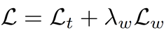
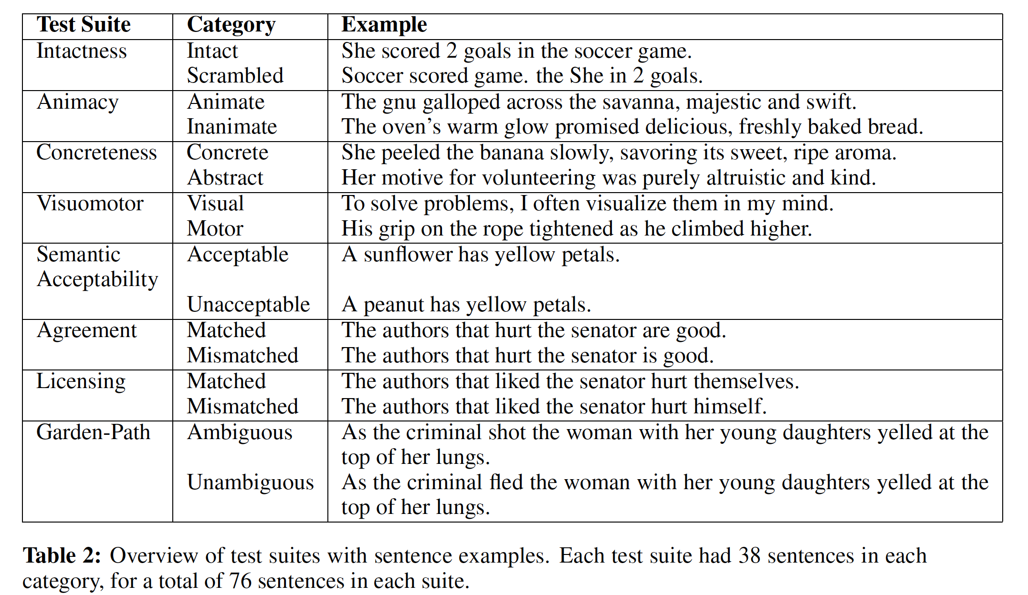
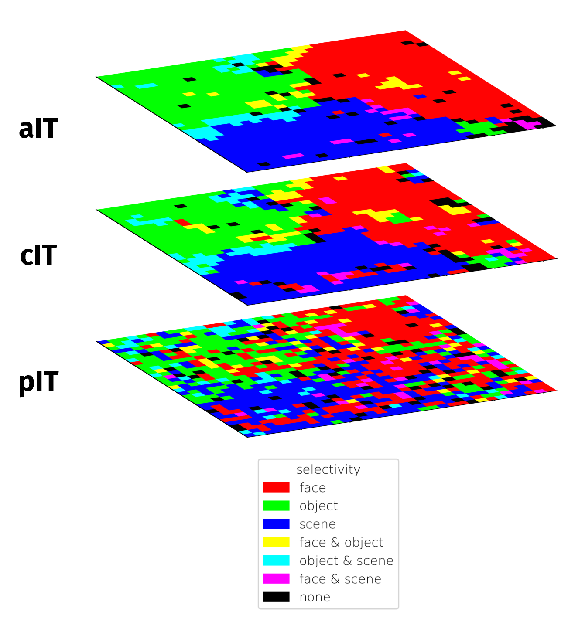
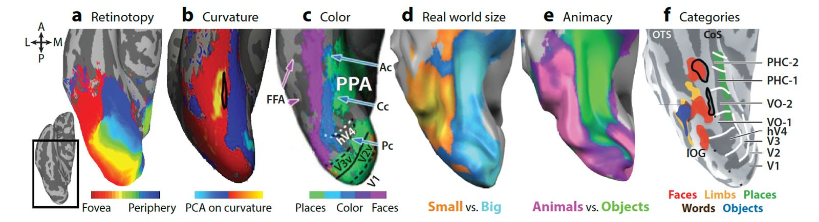
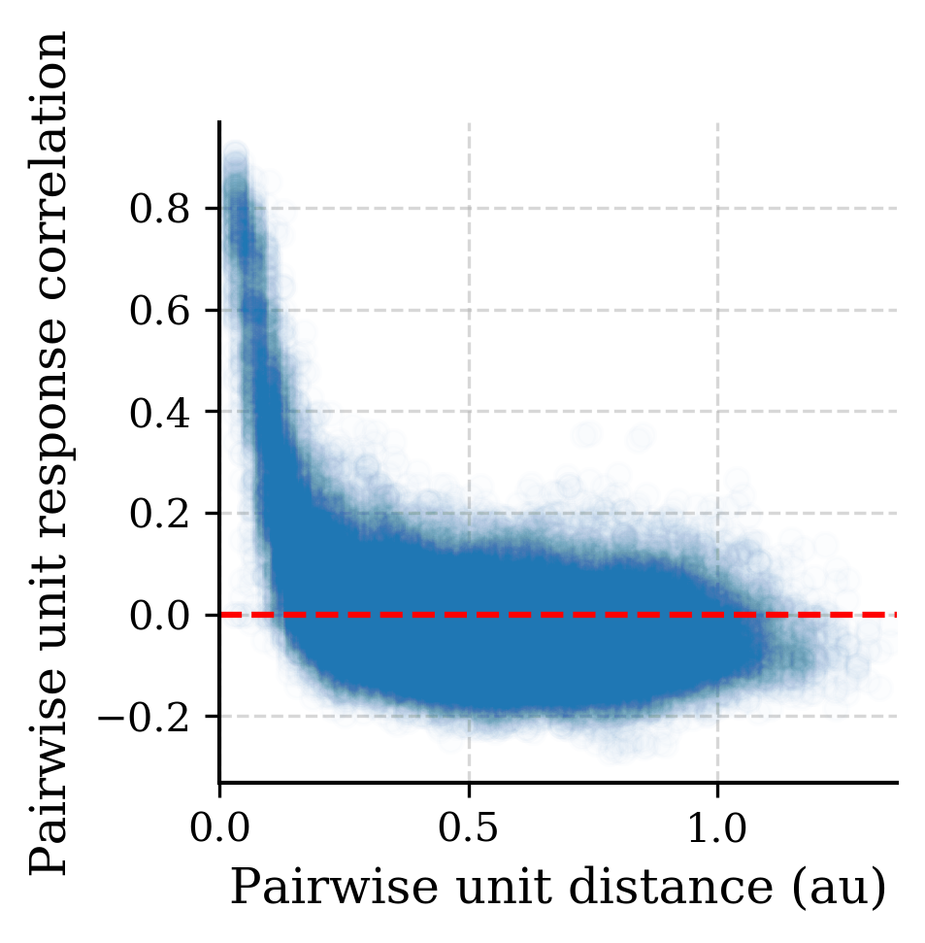
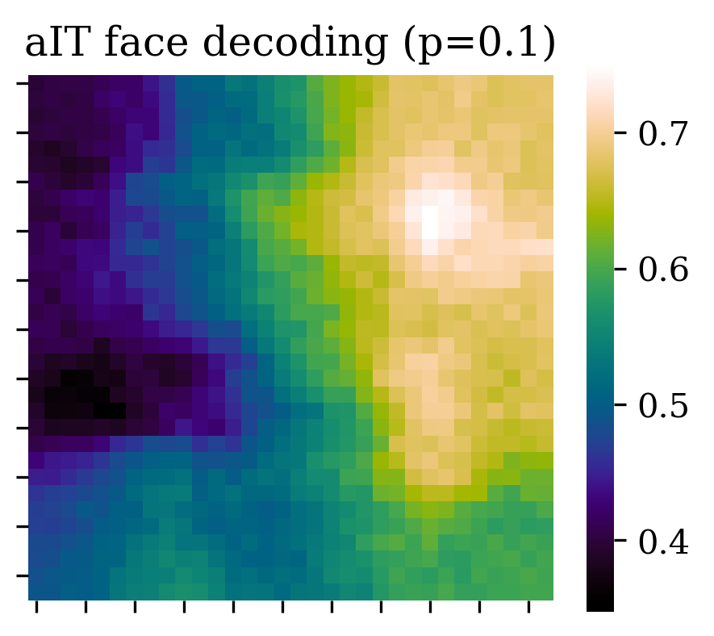
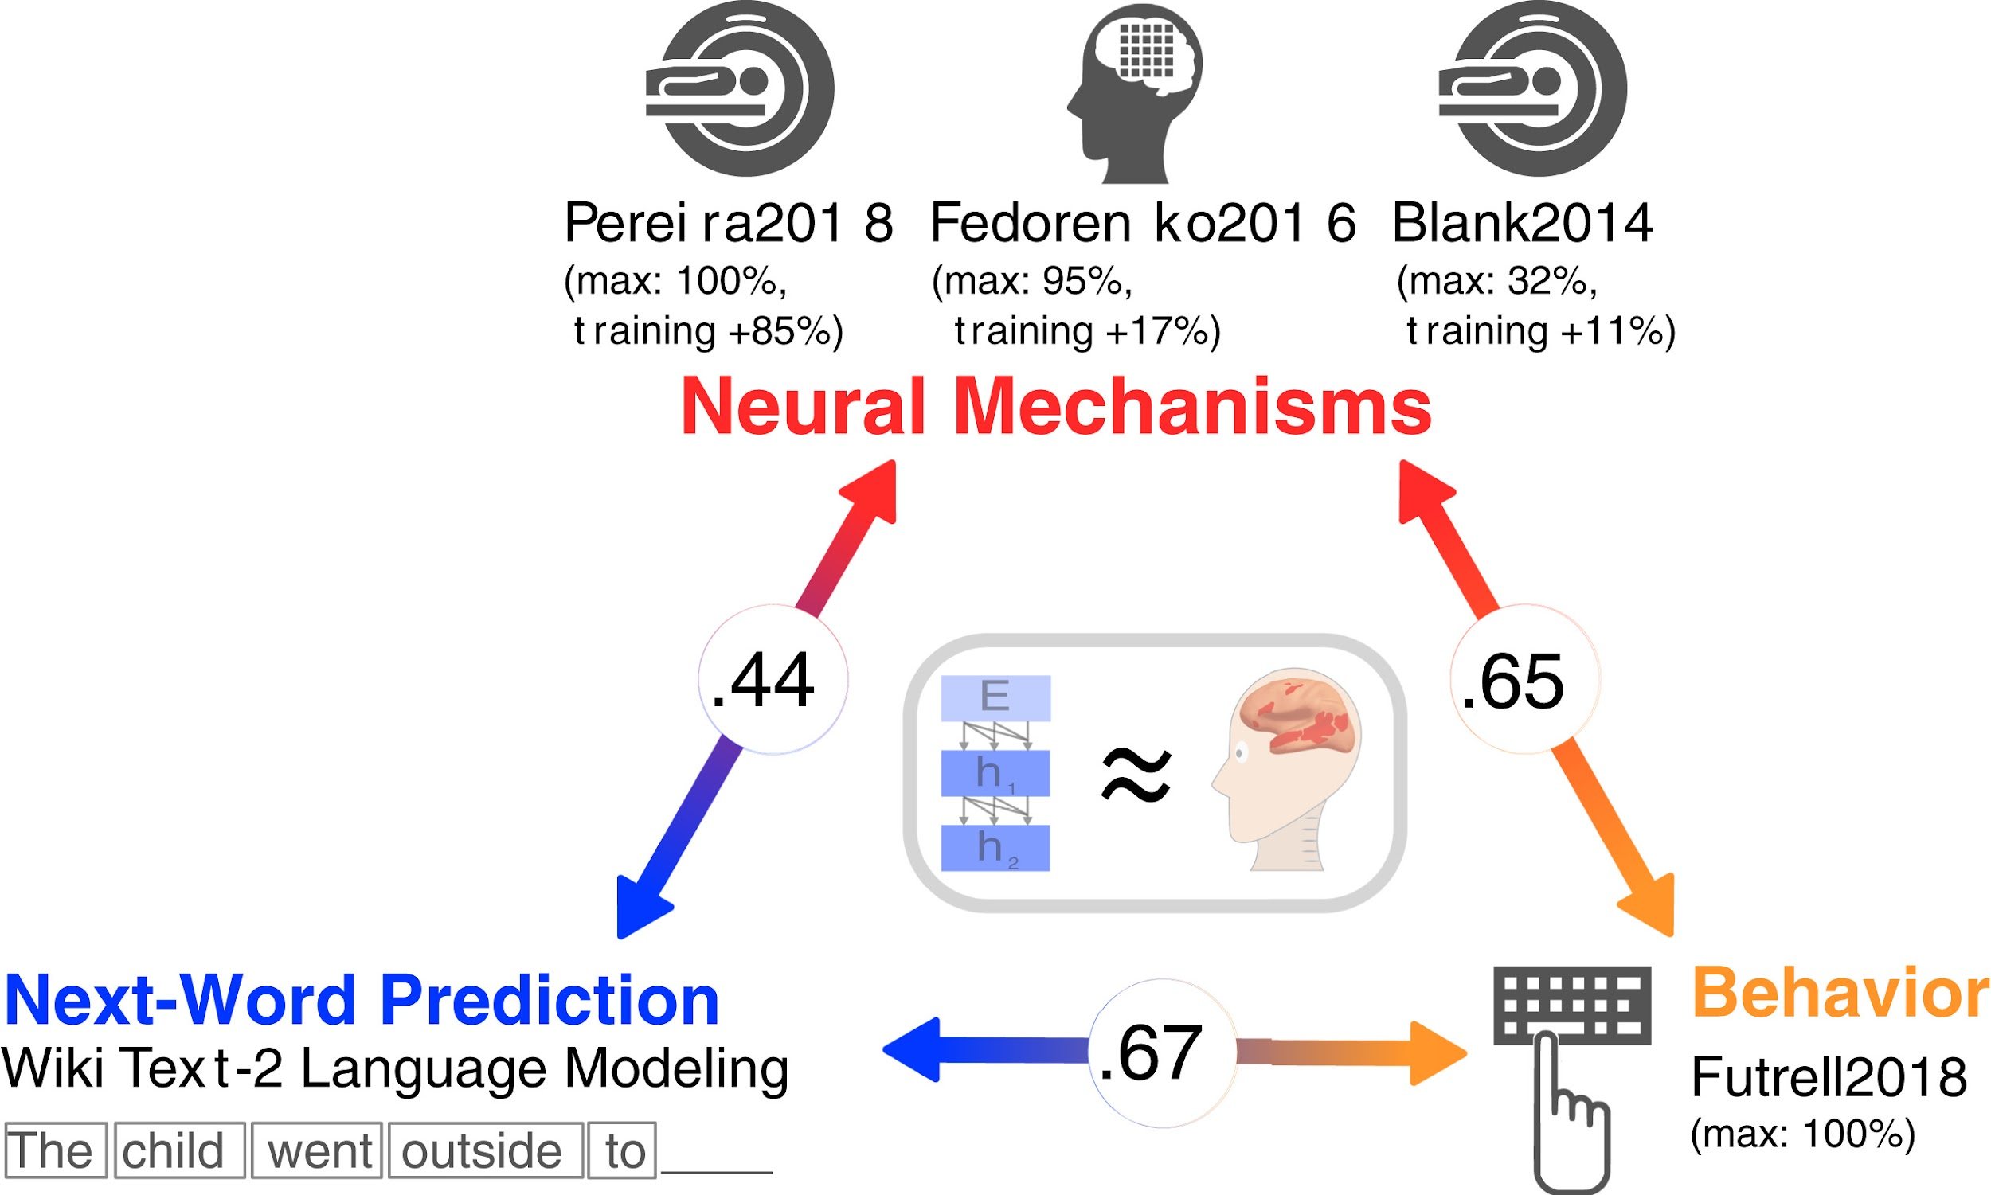
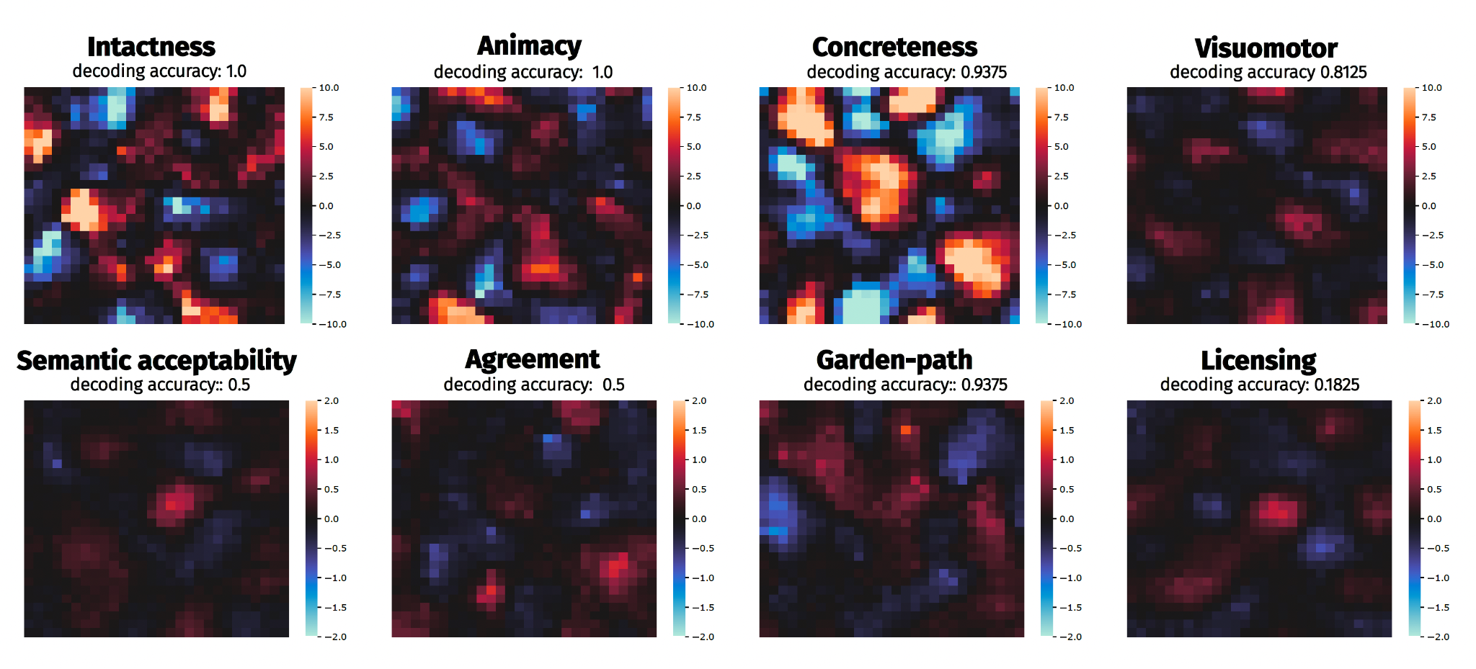
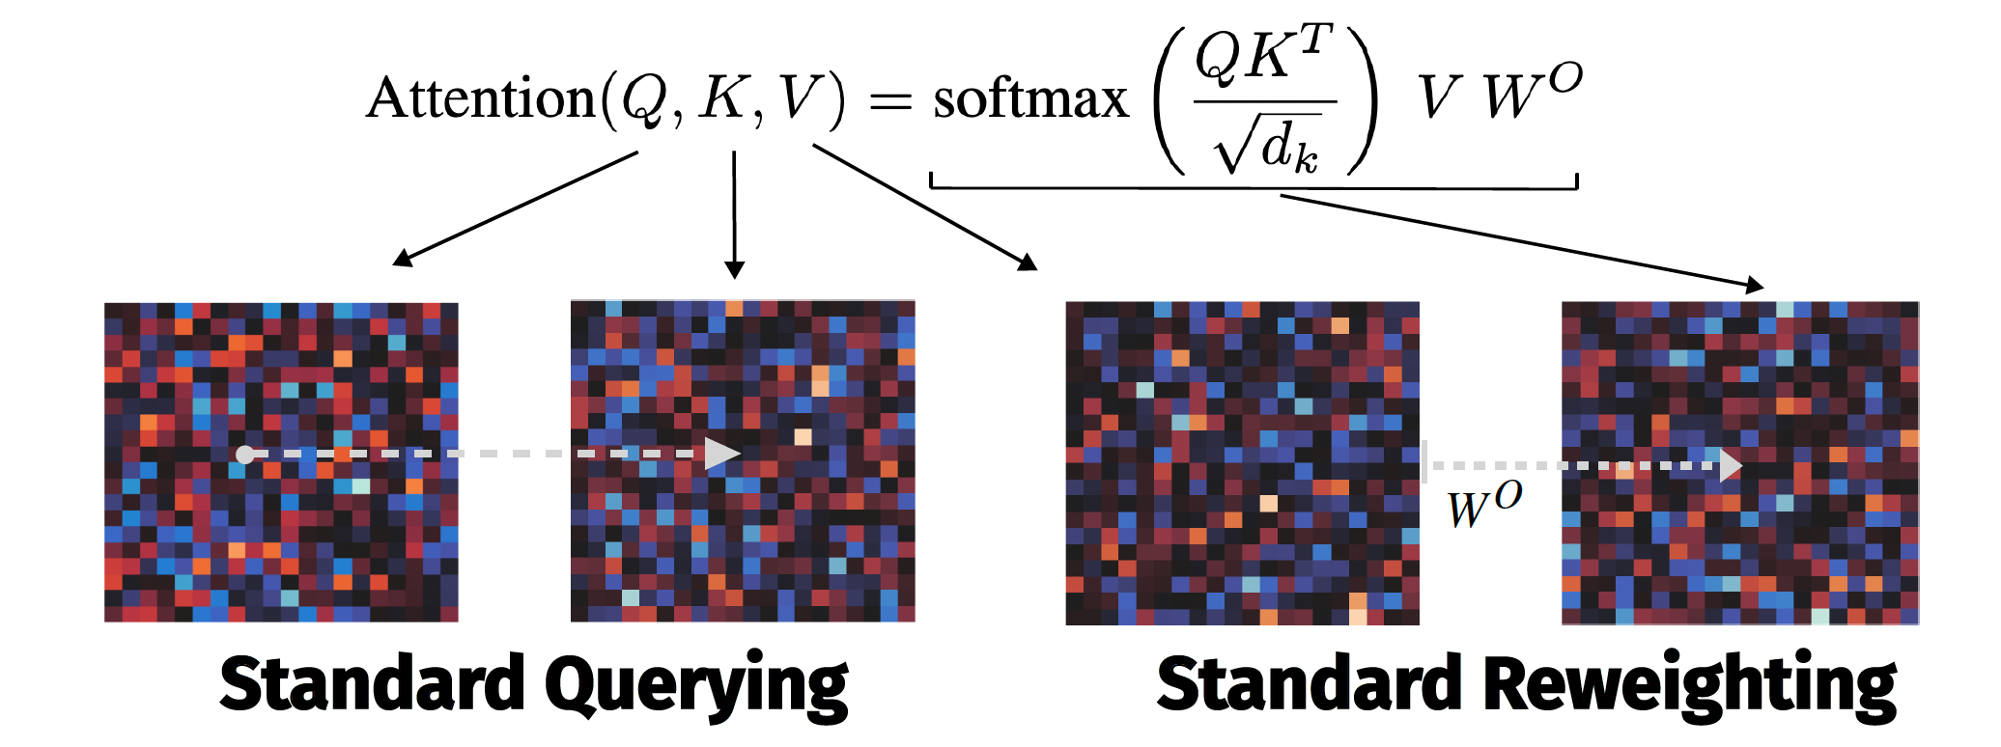
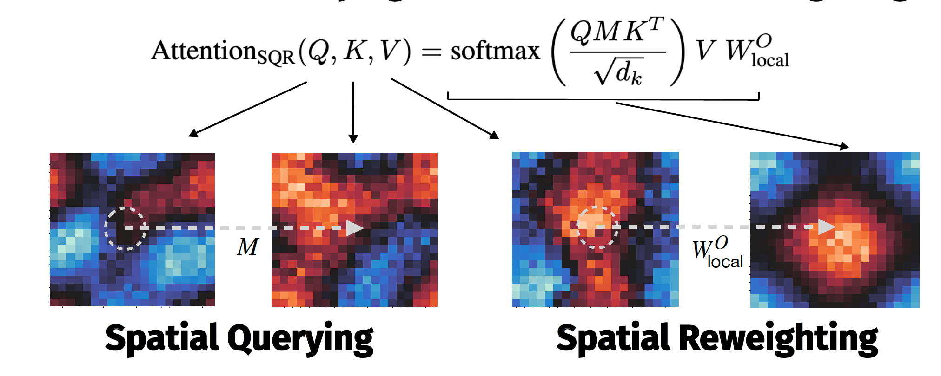


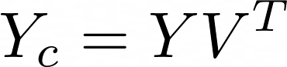
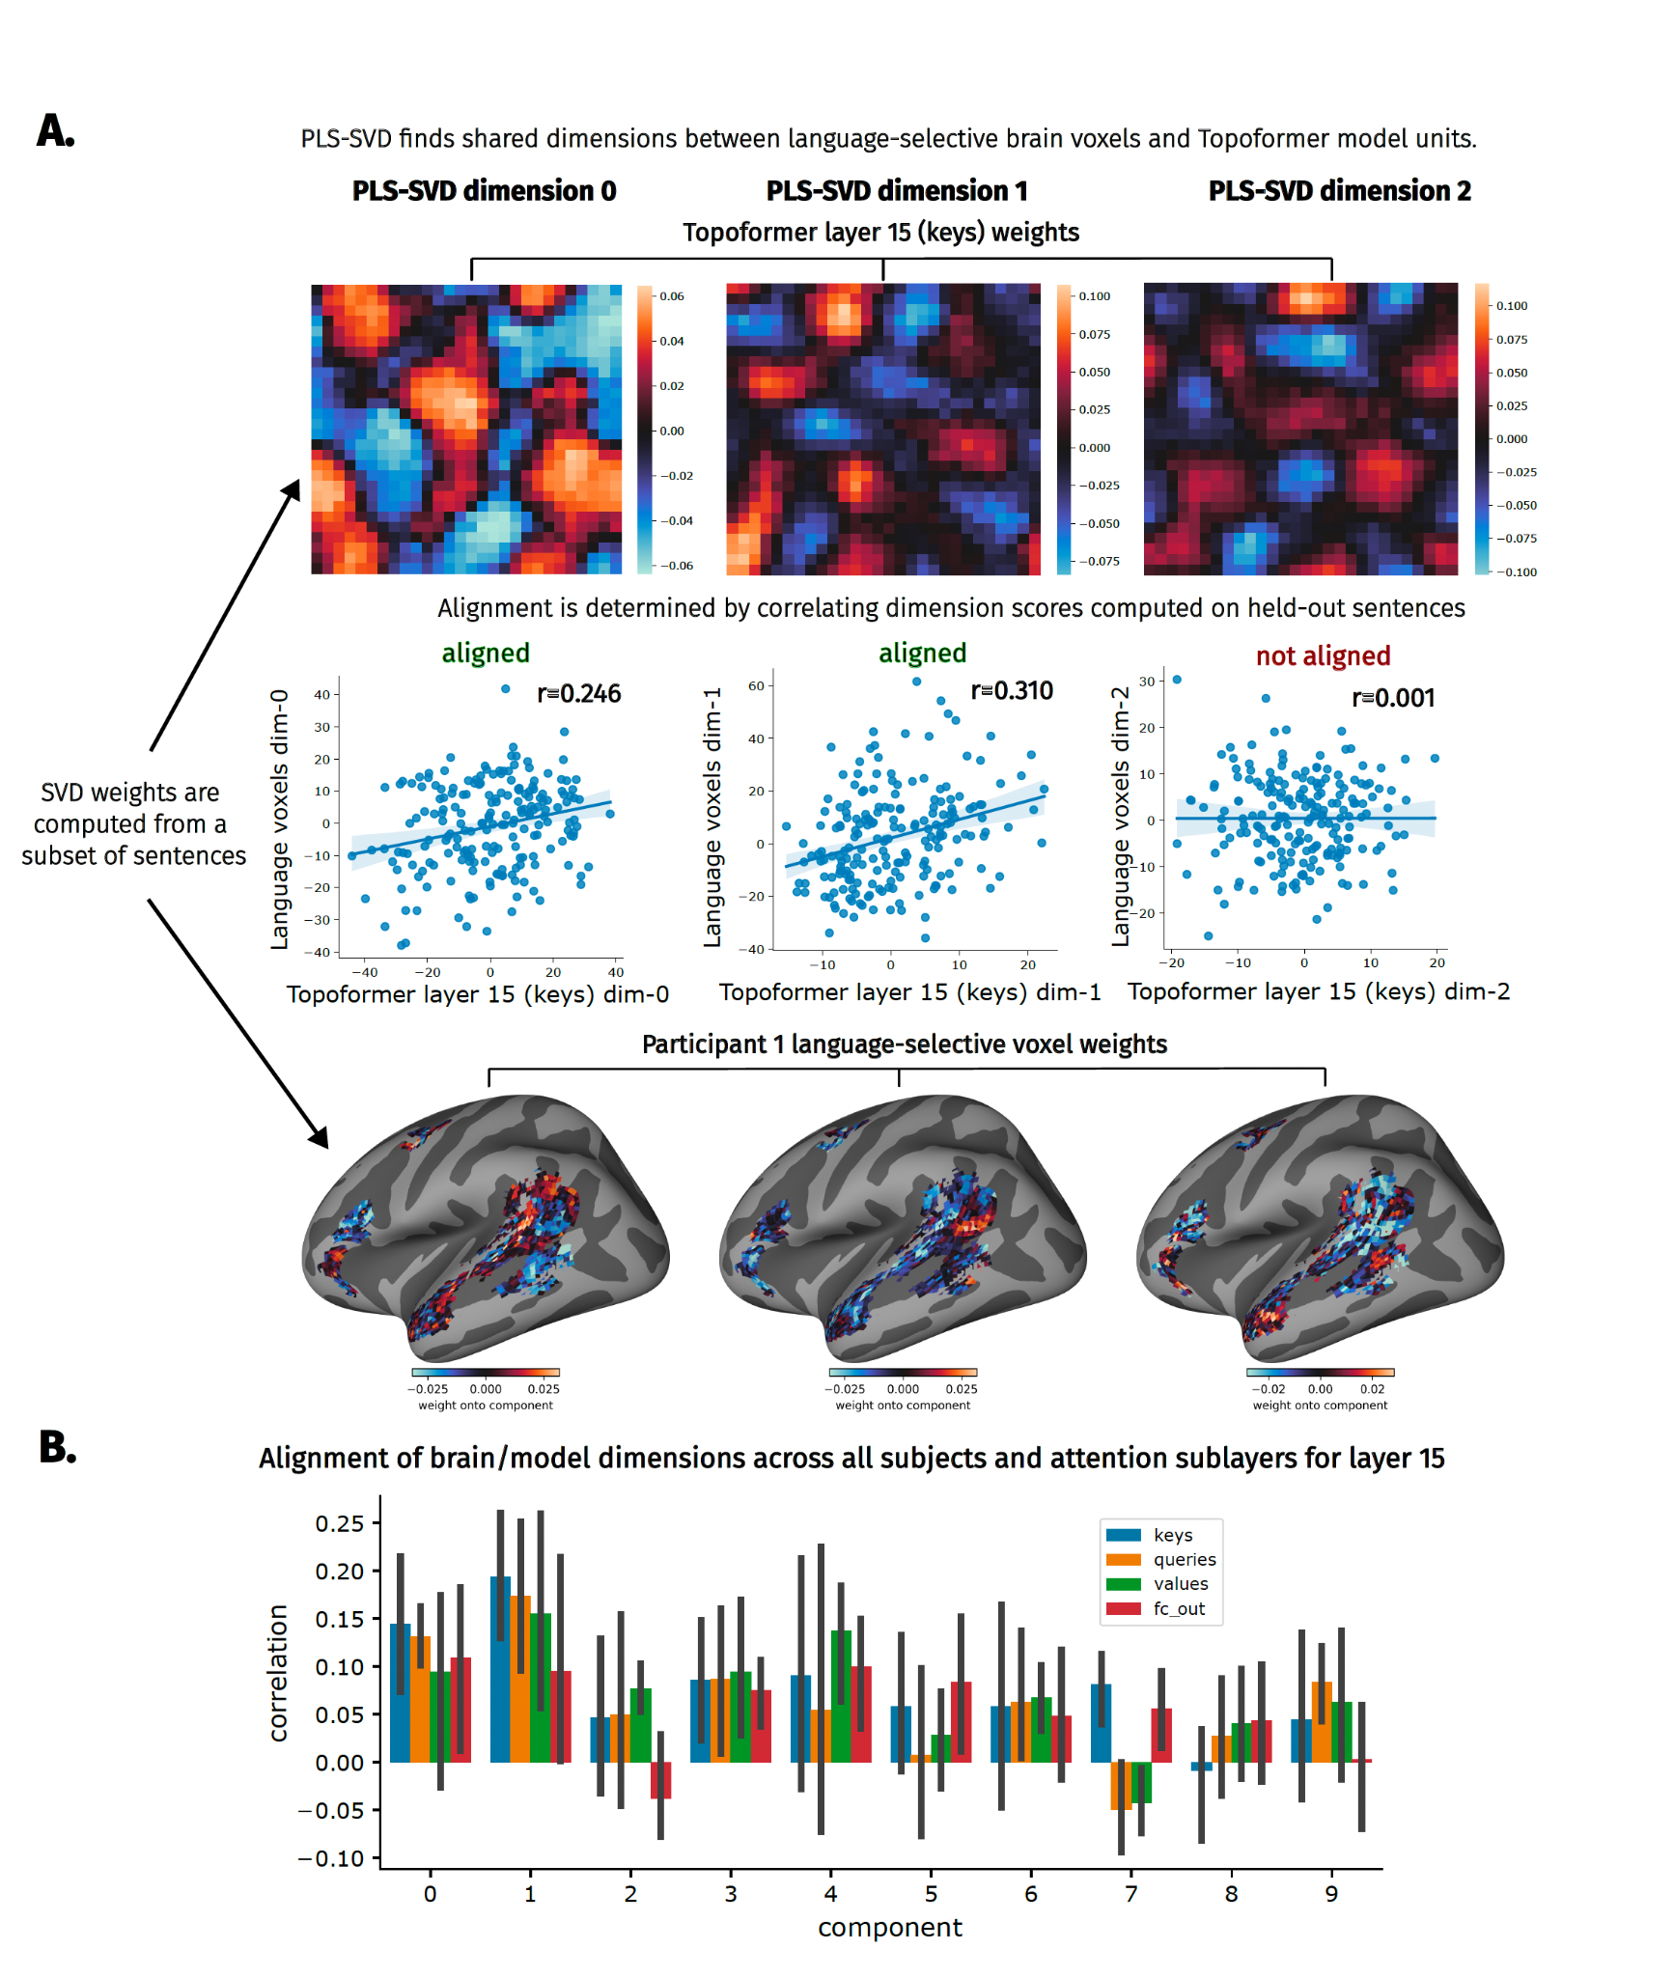
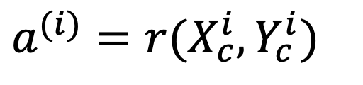
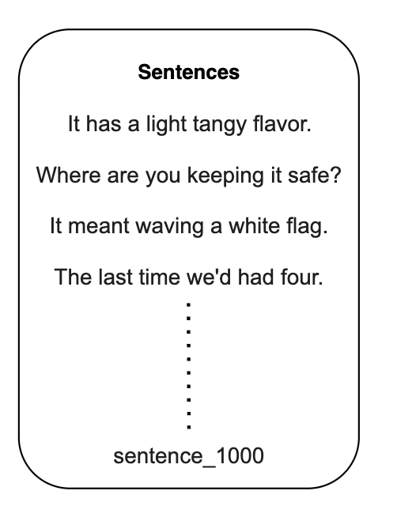
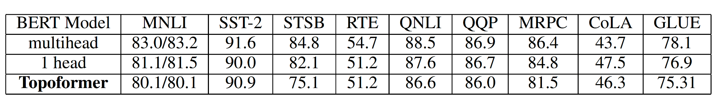
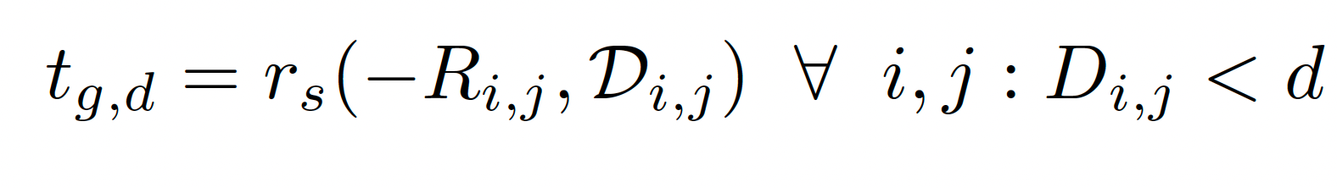
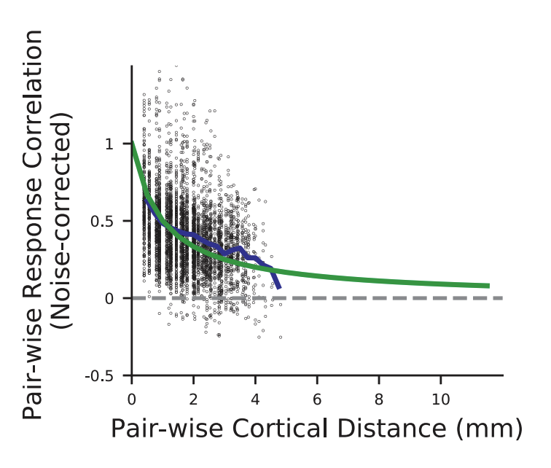
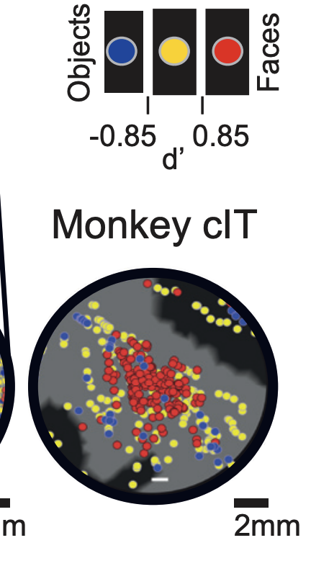
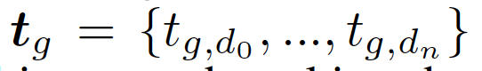
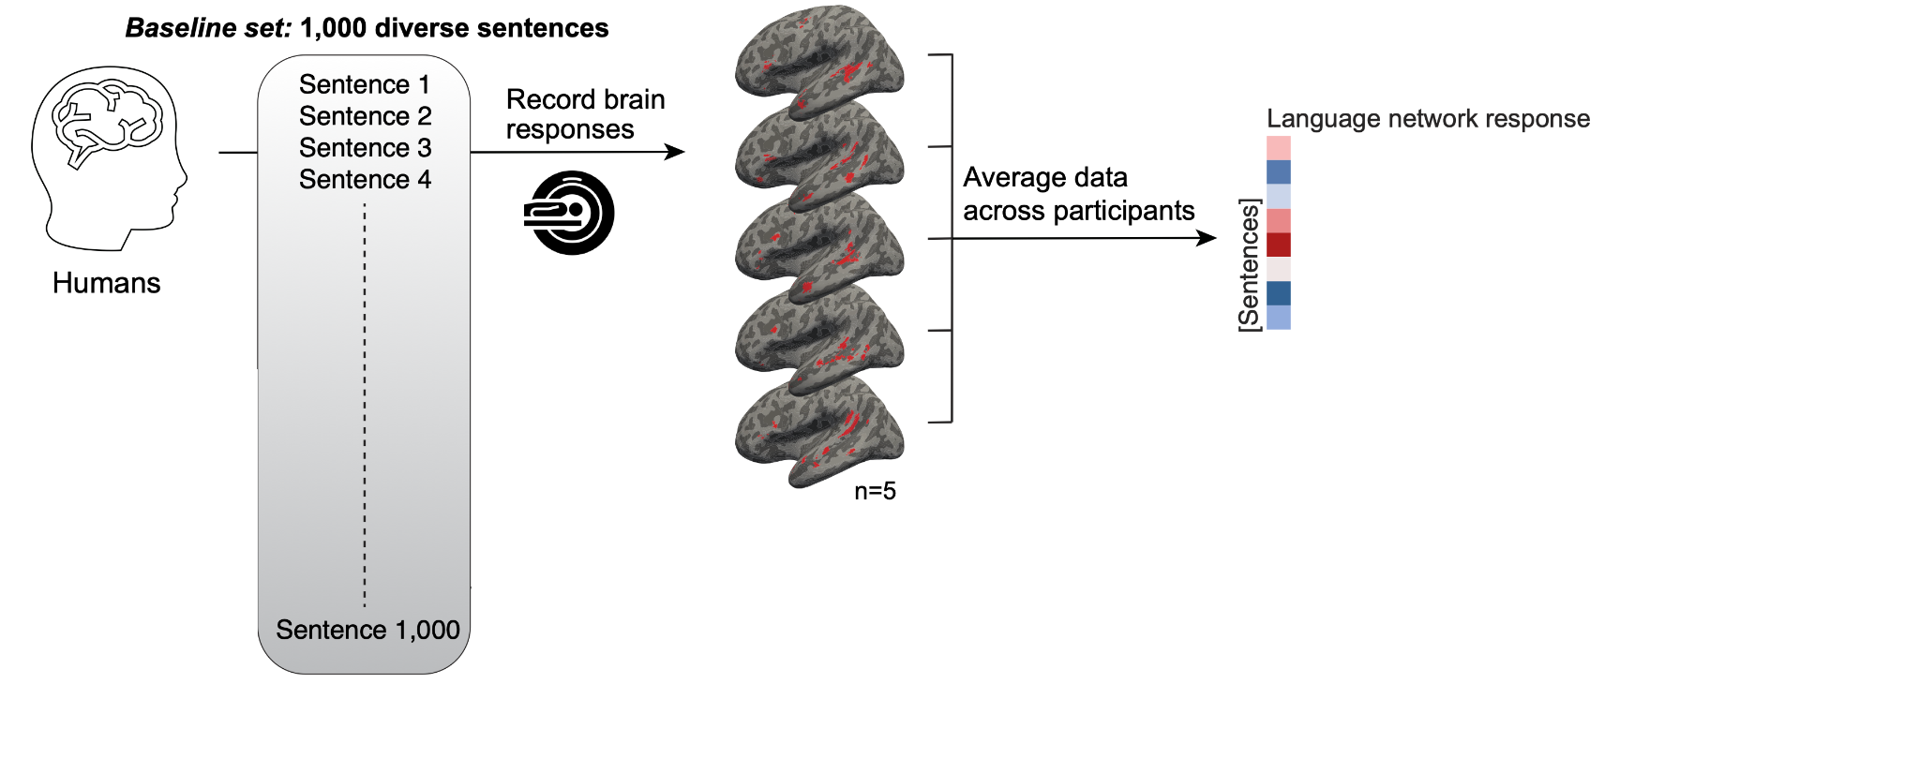
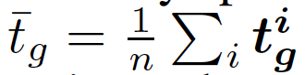
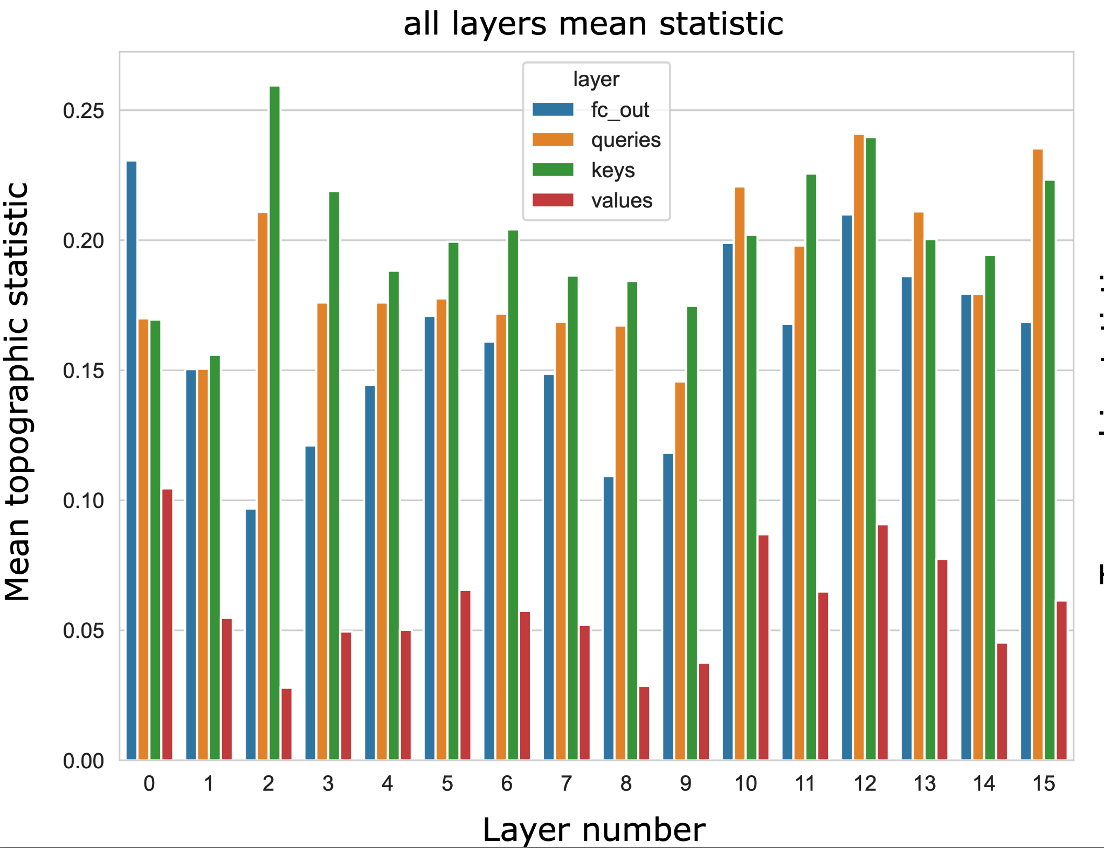
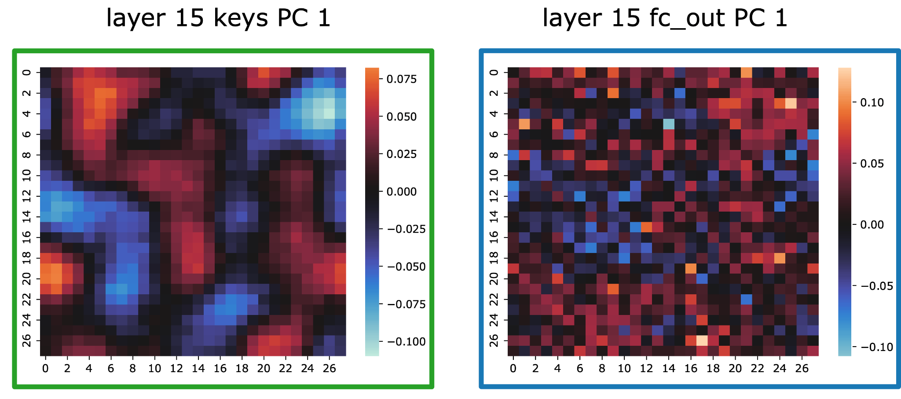
Topoformer: brain-like topographic organization in Transformer language models through spatial querying and reweighting
Taha Binhuraib¹, Greta Tuckute², Nicholas Blauch³
¹Novus Technologies, ²Department of Brain and Cognitive Sciences, Massachusetts Institute of Technology, ³Department of Psychology, Harvard University
The human brain is topographically organized
Interpreting the emergent topography
Topographic vision models have begun to explain the functional organization of the visual cortex
(task error + wiring cost)
semantic contrasts
Arcaro & Livingstone, 2024
Internal representations of Transformer large language models (LLMs) can predict human brain responses and behavior
minimal pair syntax contrasts
e.g. Interactive Topographic Network
Blauch et. al 2022
Question: Can we obtain topographic organization of linguistic representations within a transformer architecture?
Schrimpf et. al, 2021
Adding topographic priors to self-attention
Each key is associated with a single query
Fully-connected linear reweighting
Figure 3: Selectivity-based interpretation of topographic organization in Topoformer-BERT.
Brain-model alignment
Each key is associated with a spatial pool of queries
Locally-connected linear reweighting
With held-out data compute scores:
brain responses
(n x p)
model embeddings
(n x m)
brain loadings (p x d)
model loadings
(transpose)
(d x m)
Compute alignment of i-th components
singular values (d x d diag)
Figure 1: Spatial querying and reweighting operations in the “Topoformer”
Model training and evaluation
Train a single-head 16-layer Topoformer BERT model with Masked Language Modeling objective following Geiping and Goldstein's (2022) training paradigm on the Bookcorpus-Wikipedia dataset.
Evaluate task performance on the GLUE benchmark.
Table 1: Comparison of GLUE performance between non-topographic BERT control models and Topoformer-BERT
Visualizing topography
characterize topography at multiple spatial scales
Lee et. al, 2020
summarize topography over all scales
5 participants, reading 1,000 sentences in fMRI
Local correlation is a good index of topography
Quantification of topography in all layers of Topoformer-BERT
Tuckute et al., 2024
Figure 4: Alignment of topographic representations in the human language network and Topoformer-BERT model.
Conclusions and future directions
Topoformers allow for modeling of topographic organization of linguistic representations.
Low-dimensional variability can be aligned in the topographic representations of the human language network and Topoformer language model.
Topoformers hold great promise for improved interpretability of LLMs and brains, and can be applied to other domains.
Figure 2: Topographic organization cross all layers of Topoformer-BERT.
References:
Blauch, N. M., Behrmann, M., & Plaut, D. C. (2022). A connectivity-constrained computational account of topographic organization in primate high-level visual cortex. Proceedings of the National Academy of Sciences of the United States of America, 119(3). https://doi.org/10.1073/pnas.2112566119
Geiping, J., & Goldstein, T. (2023). Cramming: Training a Language Model on a single GPU in one day. In Proceedings of the International Conference on Machine Learning (pp. 11117-11143). PMLR.
Schrimpf, M., Blank, I. A., Tuckute, G., Kauf, C., Hosseini, E. A., Kanwisher, N., Tenenbaum, J. B., & Fedorenko, E. (2021). The neural architecture of language: Integrative modeling converges on predictive processing. Proceedings of the National Academy of Sciences, 118(45), e2105646118. https://doi.org/10.1073/pnas.2105646118
Arcaro, M., & Livingstone, M. (2024). A Whole-Brain Topographic Ontology. Annual Review of Neuroscience, 47. Annual Reviews.
Tuckute, G., Sathe, A., Srikant, S., Taliaferro, M., Wang, M., Schrimpf, M., Kay, K., & Fedorenko, E. (2024). Driving and suppressing the human language network using large language models. Nature Human Behaviour, 8(2), 1–18.
Lee, H., Margalit, E., Jozwik, K. M., Cohen, M. A., Kanwisher, N., Yamins, D. L. K., & DiCarlo, J. J. (2020). Topographic deep artificial neural networks reproduce the hallmarks of the primate inferior temporal cortex face processing network. BioRxiv. Advance online publication. https://doi.org/10.1101/2020.07.09.1851

